Slide 1

Database Systems: Design, Implementation, and Management Ninth Edition
Chapter 2
The Relational Database Model

Slide 2
Objectives
In this chapter, students will learn:
That the relational database model offers a logical view of data
About the relational model’s basic component: relations
That relations are logical constructs composed of rows (tuples) and columns (attributes)
That relations are implemented as tables in a relational DBMS

Slide 3

Objectives (cont’d.)
About relational database operators, the data dictionary, and the system catalog
How data redundancy is handled in the relational database model
Why indexing is important

Slide 4
A Logical View of Data
Relational model
View data logically rather than physically
Table
Structural and data independence
Resembles a file conceptually
Relational database model is easier to understand than hierarchical and network models

Slide 5
Relational Model
A relational database collects different types of data sets that use tables, records, and columns.
It is used to create a well-defined relationship between database tables so that relational databases can be easily stored.
For example of relational databases such as Microsoft SQL Server, Oracle Database, MYSQL, etc.
There are some important parameters of the relational database:
It is based on a relational model (Data in tables).
Each row in the table with a unique id, key.
Columns of the table hold attributes of data.

Slide 6
Tables and Their Characteristics
Logical view of relational database is based on relation
Relation thought of as a table
Table: two-dimensional structure composed of rows and columns
Persistent representation of logical relation
Contains group of related entities (entity set)

Slide 7
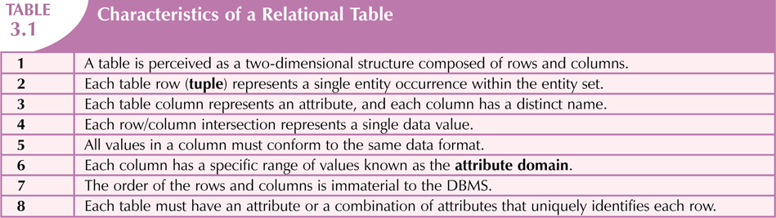

Slide 8
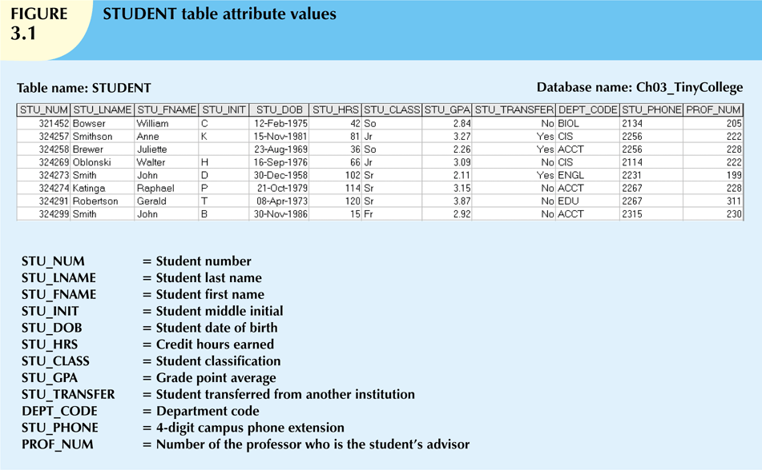

Slide 9
Keys
Each row in a table must be uniquely identifiable
Key is one or more attributes that determine other attributes
Key’s role is based on determination
If you know the value of attribute A, you can determine the value of attribute B
Functional dependence
Attribute B is functionally dependent on A if all rows in table that agree in value for A also agree in value for B
Notes:
The shorthand notation for “A determines B” is A → B. If A determines B, C, and D, you write A → B, C, D.
Therefore, using the attributes of the STUDENT table in Figure 3.1, you can represent the statement “STU_NUM determines STU_LNAME” by writing:
STU_NUM → STU_LNAME
In fact, the STU_NUM value in the STUDENT table determines all of the student’s attribute values.
For example, you can write:
STU_NUM → STU_LNAME, STU_FNAME, STU_INIT
and
STU_NUM → STU_LNAME, STU_FNAME, STU_INIT, STU_DOB, STU_TRANSFER
In contrast, STU_NUM is not determined by STU_LNAME because it is quite possible for several students to have the
last name Smith.

Slide 10
Keys (cont’d.)
Composite key
Composed of more than one attribute
Key attribute
Any attribute that is part of a key
Superkey
Any key that uniquely identifies each row
Candidate key
A superkey without unnecessary attributes
Candidate key = any key
Superkey = a set of attributes in a relation R such that no 2 different tuples will have the same values for that set of attributes

Slide 11
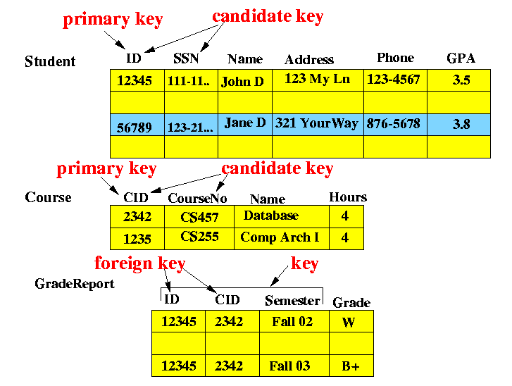
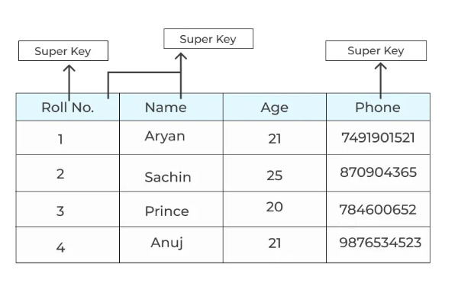

Slide 12
Keys (cont’d.)
Nulls
No data entry
Not permitted in primary key
Should be avoided in other attributes
Can represent:
An unknown attribute value
A known, but missing, attribute value
A “not applicable” condition

Slide 13
Keys (cont’d.)
Nulls (cont’d.)
Can create problems when functions such as COUNT, AVERAGE, and SUM are used
Can create logical problems when relational tables are linked

Slide 14

Keys (cont’d.)
Controlled redundancy
Makes the relational database work
Tables within the database share common attributes
Enables tables to be linked together
Multiple occurrences of values not redundant when required to make the relationship work
Redundancy exists only when there is unnecessary duplication of attribute values

Slide 15
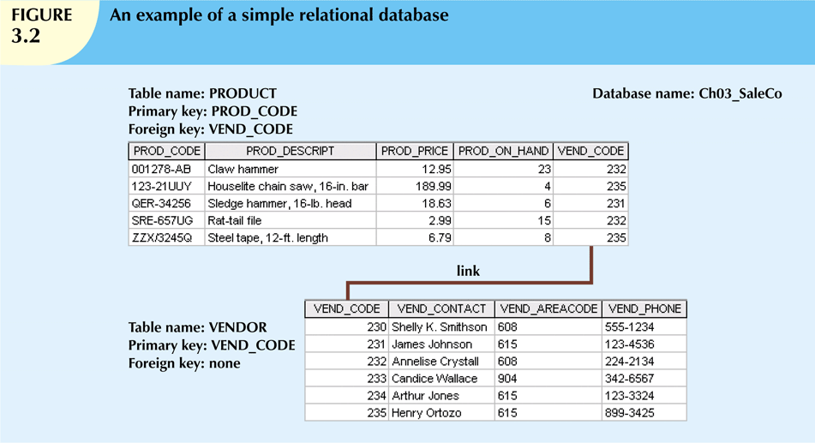
Notes:
As you examine Figure 3.2, note that the VEND_CODE value in one table can be used to point to the corresponding
value in the other table.
For example, the VEND_CODE value 235 in the PRODUCT table points to vendor Henry
Ortozo in the VENDOR table.
Consequently, you discover that the product “Houselite chain saw, 16-in. bar” is delivered by
Henry Ortozo and that he can be contacted by calling 615-899-3425.
The same connection can be made for the product “Steel tape, 12-ft. length” in the PRODUCT table.

Slide 16
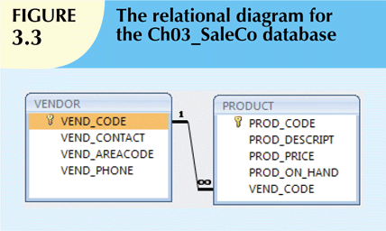
Notes:
This link is created when two tables share an attribute with common values. More specifically, the primary key of one table (VENDOR) appears as the
foreign key in a related table (PRODUCT).
A foreign key (FK) is an attribute whose values match the primary key values in the related table.

Slide 17
Keys (cont’d.)
Foreign key (FK)
An attribute whose values match primary key values in the related table
Referential integrity
FK contains a value that refers to an existing valid tuple (row) in another relation
Secondary key
Key used strictly for data retrieval purposes

Slide 18
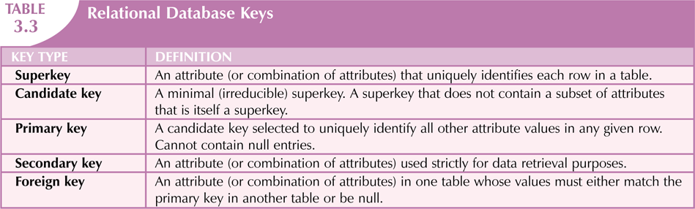

Slide 19
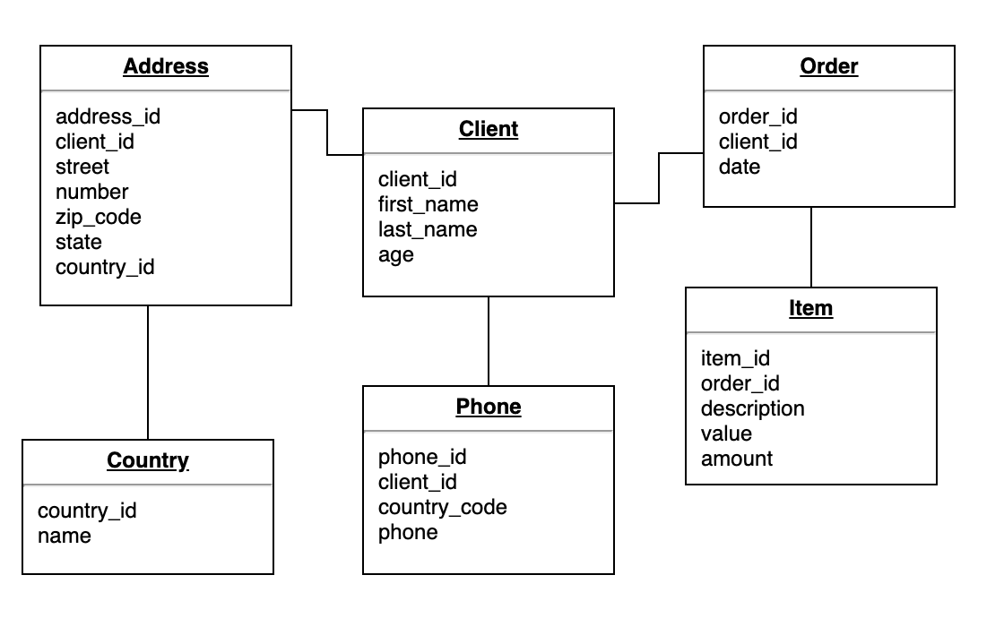
QUICK TUTORIAL
Simplify the table below to a relational schema
Underline the Primary key and Foreign key

Slide 20
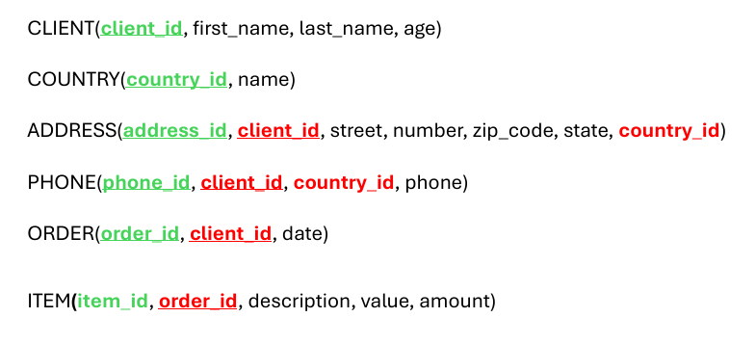
Sample solutions- Relational Schema

Slide 21
Integrity Rules
Many RDBMs enforce integrity rules automatically
Safer to ensure that application design conforms to entity and referential integrity rules
Designers use flags to avoid nulls
Flags indicate absence of some value
Notes:
Integrity constraints are rules that help to maintain the accuracy and consistency of data in a database.
They can be used to enforce business rules or to ensure that data is entered correctly.
For example, a simple integrity constraint in DBMS might state that all customers must have a valid email address.

Slide 22
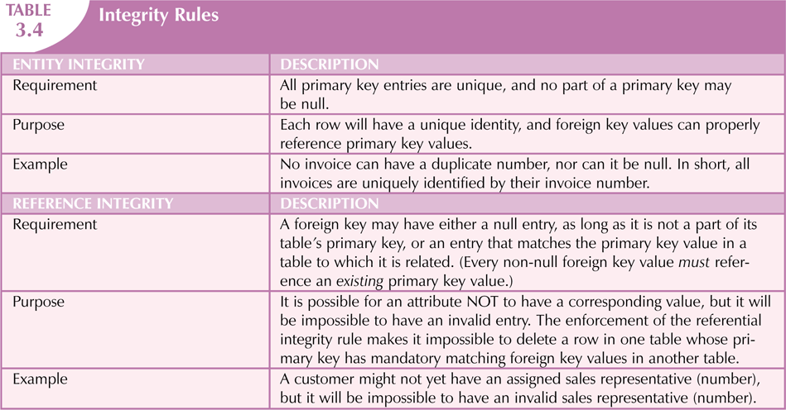
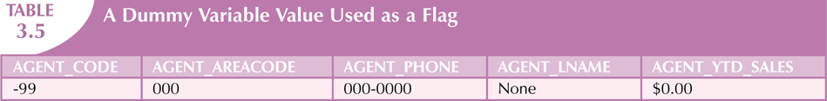

Slide 23
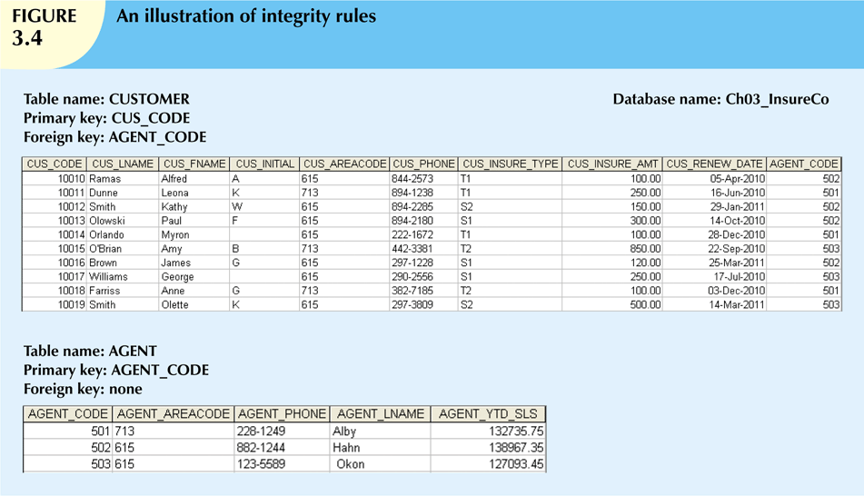

Slide 24
The Data Dictionary and System Catalog
Data dictionary
Provides detailed accounting of all tables found within the user/designer-created database
Contains (at least) all the attribute names and characteristics for each table in the system
Contains metadata: data about data
System catalog
Contains metadata
Detailed system data dictionary that describes all objects within the database

Slide 25
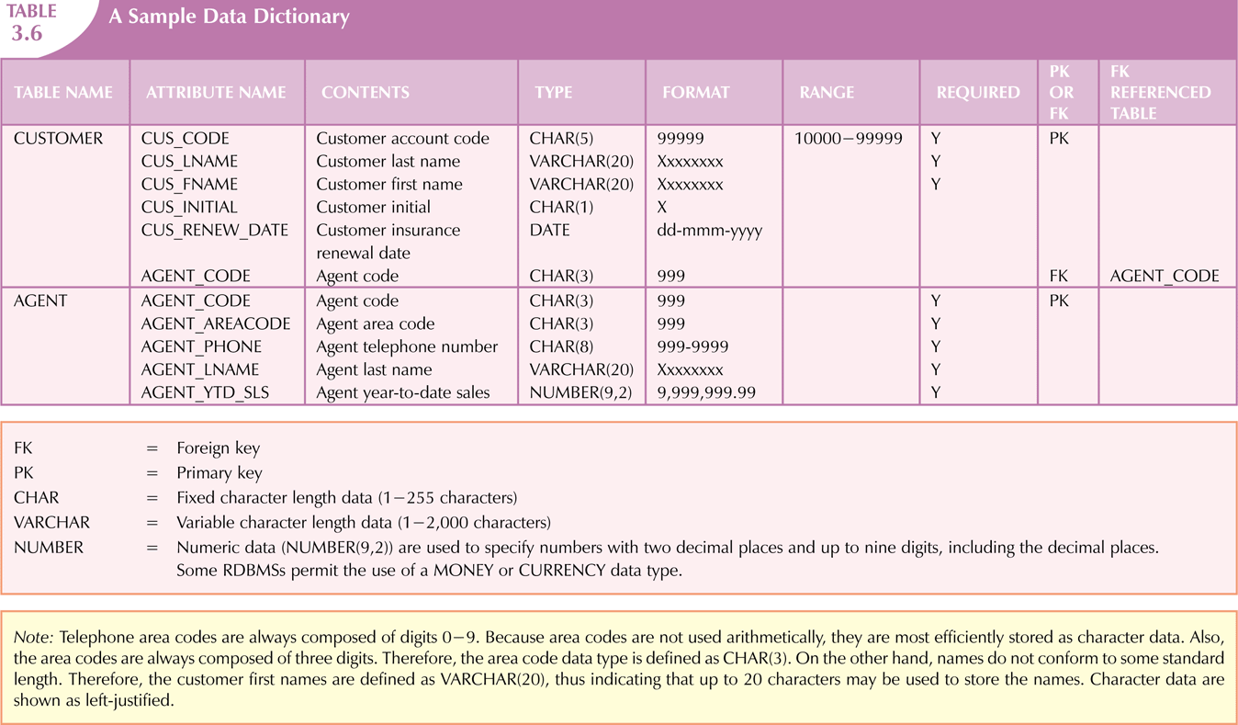
Notes:
As new tables are added to the database, that documentation also allows the RDBMS to check for and eliminate homonyms and synonyms
a database context, the word homonym indicates the use of the same attribute name to label different attributes.
For example, you might use C_NAME to label a customer name attribute in a CUSTOMER table
and also use C_NAME to label a consultant name attribute in a CONSULTANT table.
To lessen confusion, you should avoid database homonyms; the data dictionary is very useful in this regard.
a synonym is the opposite of a homonym and indicates the use of different names to describe the same attribute.

Slide 26

Relationships within the Relational Database
1:M relationship
Relational modeling ideal
Should be the norm in any relational database design
1:1 relationship
Should be rare in any relational database design

Slide 27
Relationships within the Relational Database (cont’d.)
M:N relationships
Cannot be implemented as such in the relational model
M:N relationships can be changed into 1:M relationships

Slide 28
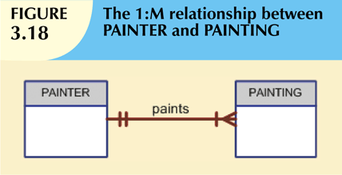
The 1:M Relationship
Relational database norm
Found in any database environment

Slide 29
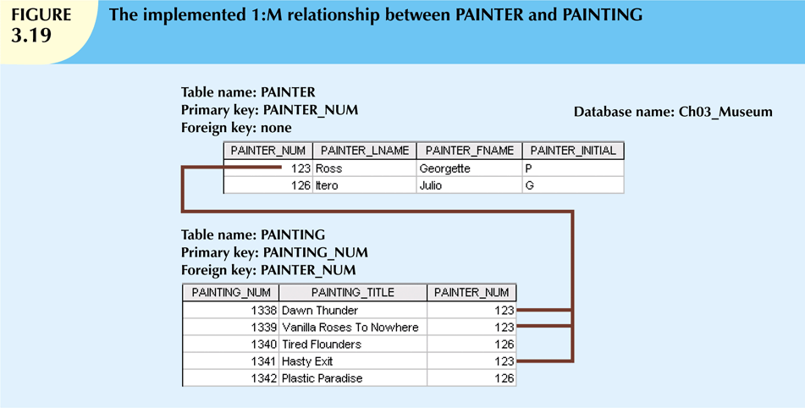

Slide 30
The 1:1 Relationship
One entity related to only one other entity, and vice versa
Sometimes means that entity components were not defined properly
Could indicate that two entities actually belong in the same table
Certain conditions absolutely require their use

Slide 31
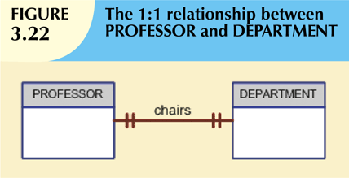

Slide 32

The M:N Relationship
Implemented by breaking it up to produce a set of 1:M relationships
Avoid problems inherent to M:N relationship by creating a composite entity
Includes as foreign keys the primary keys of tables to be linked

Slide 33
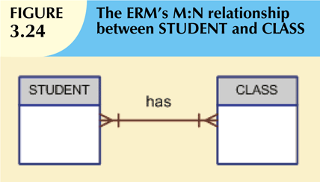

Slide 34
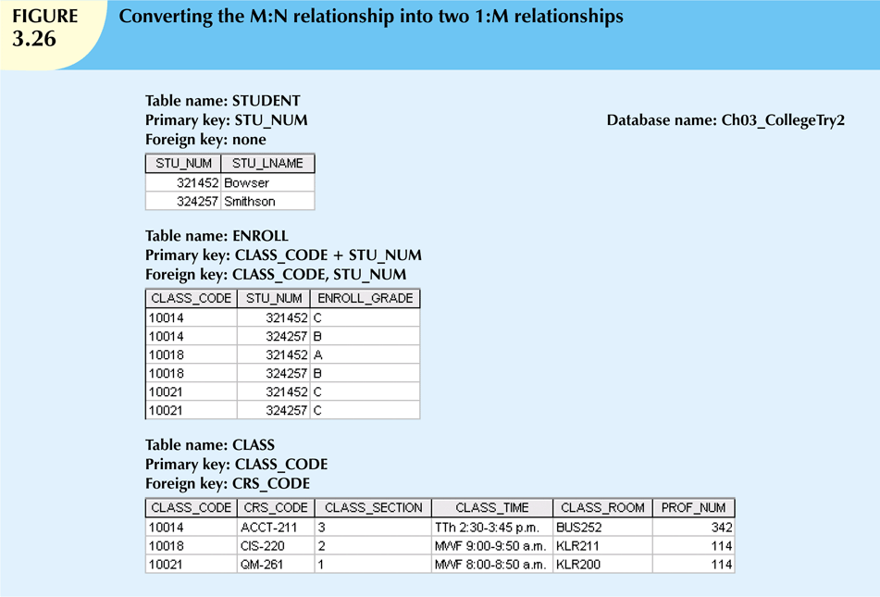

Slide 35
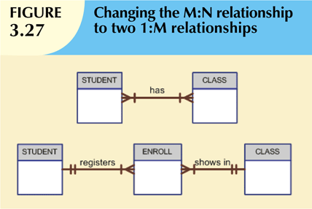

Slide 36
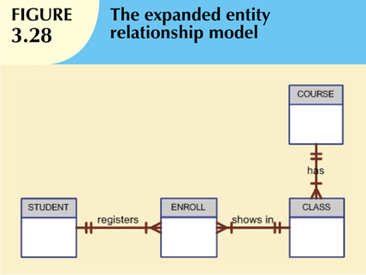

Slide 37
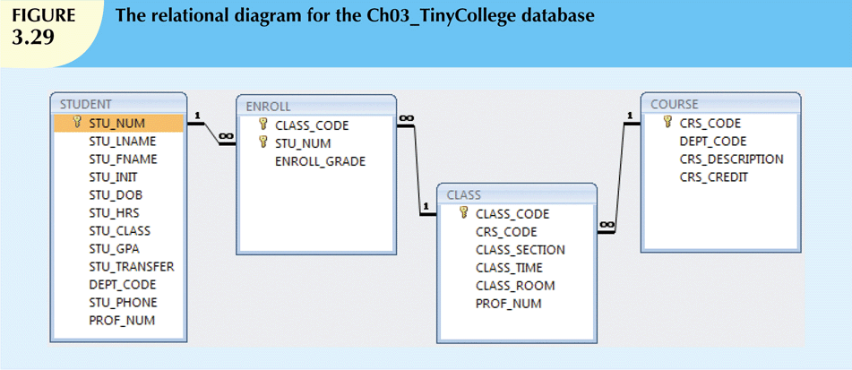

Slide 38

Data Redundancy Revisited
Data redundancy leads to data anomalies
Can destroy the effectiveness of the database
Foreign keys
Control data redundancies by using common attributes shared by tables
Crucial to exercising data redundancy control

Slide 39
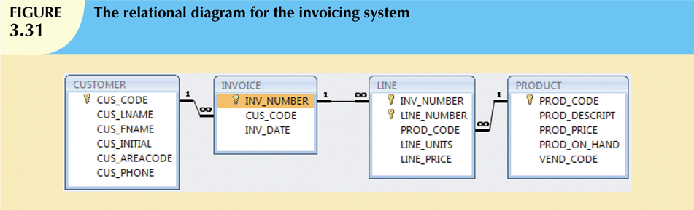
Notes:
Figure 3.31, note that you can keep track of typical sales information.
For example, by tracing the relationships among the four tables, you discover that
customer 10014 (Myron Orlando) bought two items on March 8, 2010, that were written to invoice
number 1001: one Houselite chain saw with a 16-inch bar and three rat-tail files.
(Note: Trace the CUS_CODE number 10014 in the CUSTOMER table to the matching CUS_CODE value in the INVOICE table. Next, take the
INV_NUMBER 1001 and trace it to the first two rows in the LINE table. Finally, match the two PROD_CODE values
in LINE with the PROD_CODE values in PRODUCT.)
Application software will be used to write the correct bill by multiplying each invoice line item’s LINE_UNITS by its LINE_PRICE, adding the results, applying appropriate taxes,
etc. Later, other application software might use the same technique to write sales reports that track and compare sales by week, month, or year.

Slide 40
Indexes
Orderly arrangement to logically access rows in a table
Index key
Index’s reference point
Points to data location identified by the key
Unique index
Index in which the index key can have only one pointer value (row) associated with it
Each index is associated with only one table

Slide 41
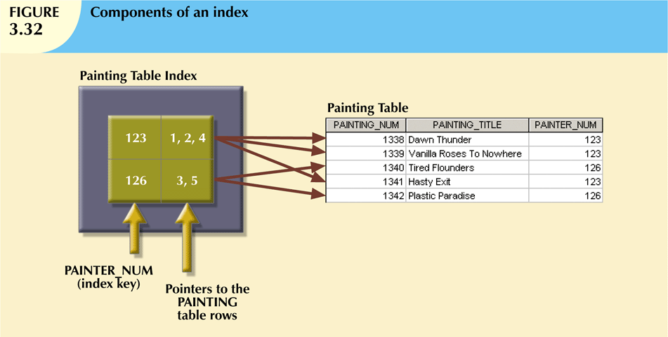
Notes:
As you examine Figure 3.32, note that the first PAINTER_NUM index key value (123) is found in records 1, 2,
and 4 of the PAINTING table. The second PAINTER_NUM index key value (126) is found in records 3 and 5 of the
PAINTING table.
You just learned that an index can be used to retrieve data more efficiently.
But indexes can also be used by a DBMS to retrieve data ordered by a specific attribute or attributes

Slide 42
Relational Set Operators
Relational algebra
Defines theoretical way of manipulating table contents using relational operators
Use of relational algebra operators on existing relations produces new relations:
SELECT | DIFFERENCE
PROJECT | JOIN
UNION | PRODUCT
INTERSECT | DIVIDE

Slide 43
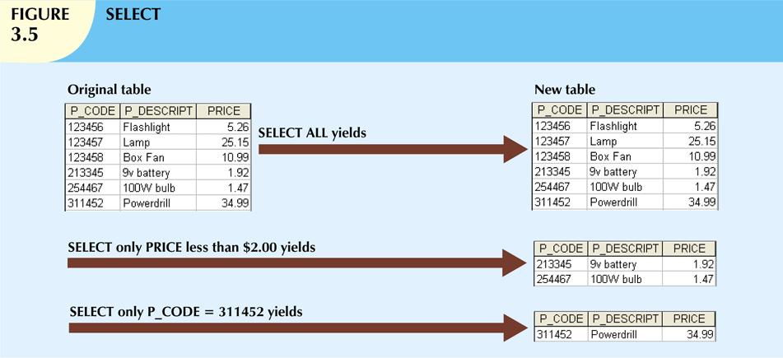
The SELECT statement is used to select data from a database. The data returned is stored in a result table, called the result-set.
Notes:
SELECT, also known as RESTRICT, yields values for all rows found in a table that satisfy a given condition.
SELECT can be used to list all of the row values, or it can yield only those row values that match a specified
criterion. In other words, SELECT yields a horizontal subset of a table. The effect of a SELECT is shown in
Figure 3.5.

Slide 44
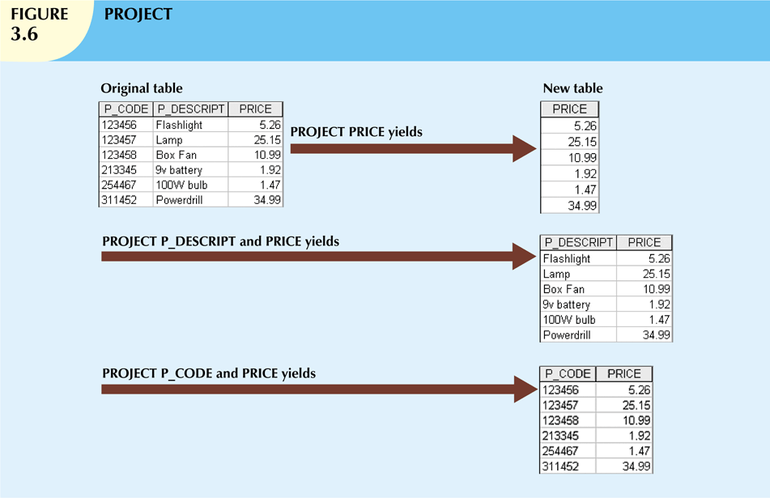
selecting the values of a few attributes, rather than selection all attributes of the Table (Relation),
Notes:
PROJECT yields all values for selected attributes. In other words, PROJECT yields a vertical subset of a table.
The effect of a PROJECT is shown in Figure 3.6.

Slide 45
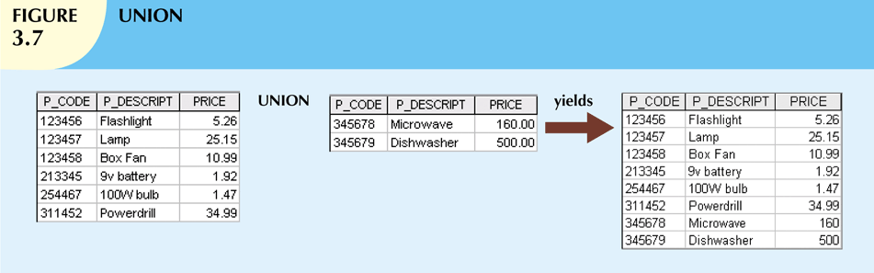
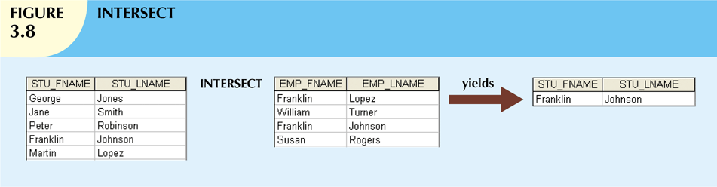
UNION : Combine all results from two table into a single result, omitting any duplicates.
INTERSECT : Combine only those rows which the results of two table have in common, omitting any duplicates.
Notes:
UNION combines all rows from two tables, excluding duplicate rows. The tables must have the same attribute
characteristics (the columns and domains must be compatible) to be used in the UNION. When two or more
tables share the same number of columns, and when their corresponding columns share the same (or
compatible) domains, they are said to be union-compatible. The effect of a UNION is shown in Figure 3.7.
INTERSECT yields only the rows that appear in both tables. As was true in the case of UNION, the tables must
be union-compatible to yield valid results. For example, you cannot use INTERSECT if one of the attributes is
numeric and one is character-based. The effect of an INTERSECT is shown in Figure 3.8

Slide 46
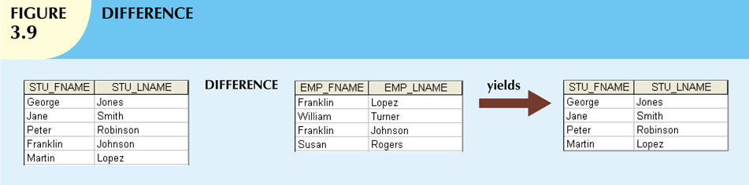
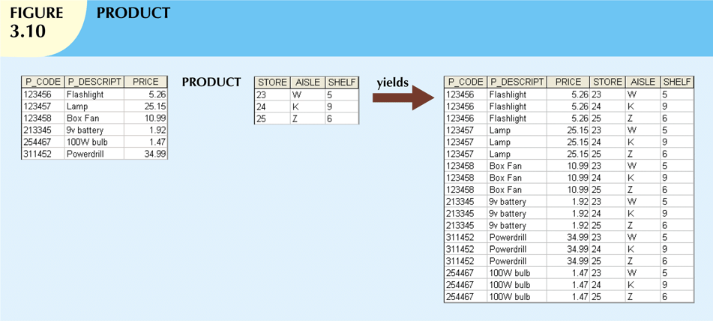
DIFFERENCE yields all rows in one table that are not found in the other table;
PRODUCT yields all possible pairs of rows from two tables—also known as the Cartesian product.
Notes:
DIFFERENCE yields all rows in one table that are not found in the other table; that is, it subtracts one table
from the other. As was true in the case of UNION, the tables must be union-compatible to yield valid results.
The effect of a DIFFERENCE is shown in Figure 3.9. However, note that subtracting the first table from the
second table is not the same as subtracting the second table from the first table.
PRODUCT yields all possible pairs of rows from two tables—also known as the Cartesian product.
Therefore, if one table has six rows and the other table has three rows, the PRODUCT yields a list composed of 6 × 3
= 18 rows. The effect of a PRODUCT is shown in Figure 3.10.

Slide 47
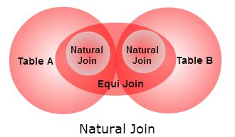
Relational Set Operators (cont’d.)
Natural Join
Links tables by selecting rows with common values in common attribute(s)
Equijoin
Links tables on the basis of an equality condition that compares specified columns
Theta join
Any other comparison operator is used
Outer join
Matched pairs are retained, and any unmatched values in other table are left null

Slide 48
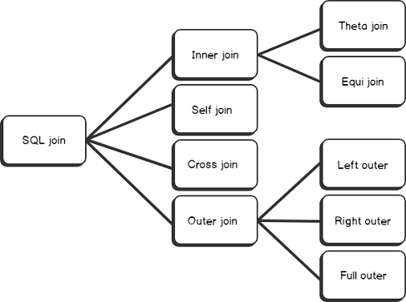

Slide 49
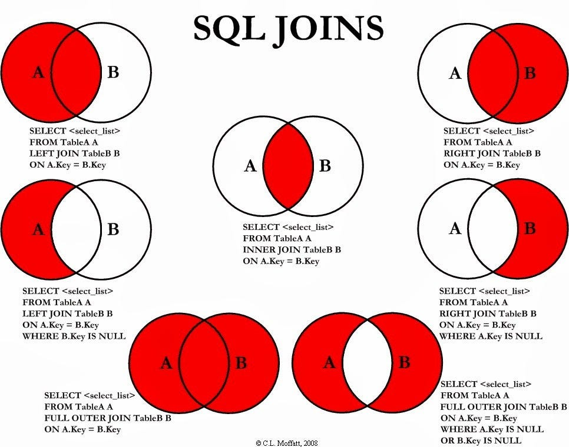

Slide 50
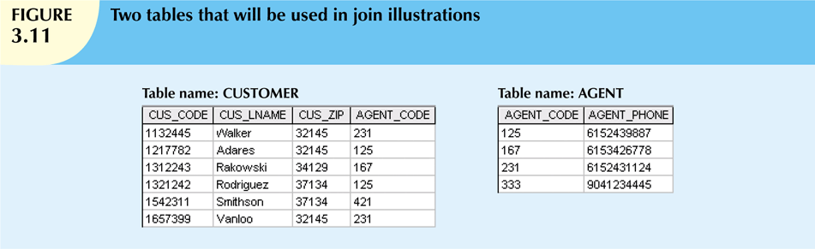

Slide 51
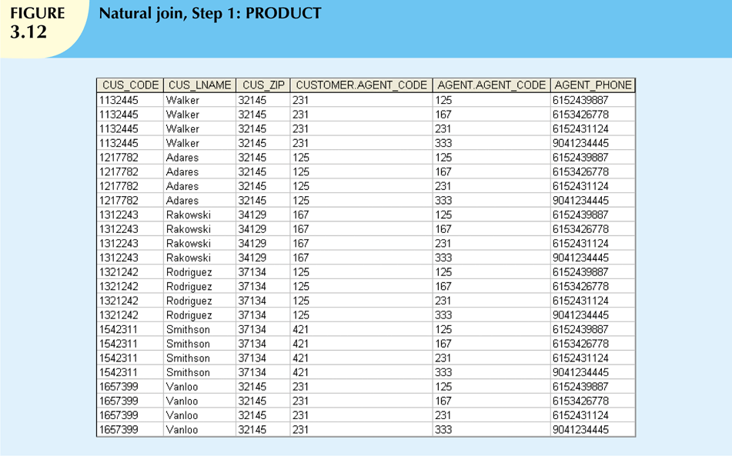

Slide 52
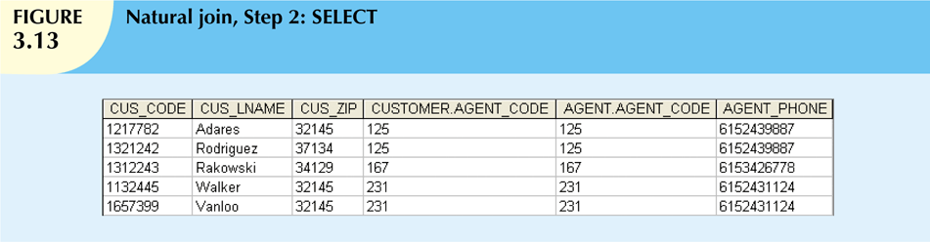
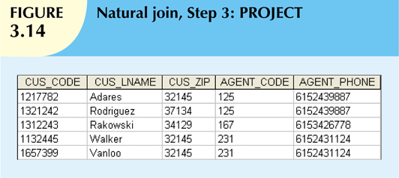

Slide 53
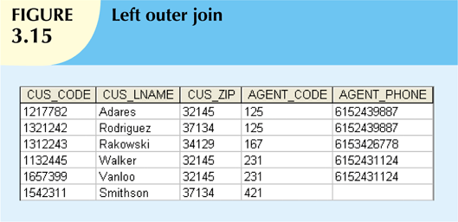
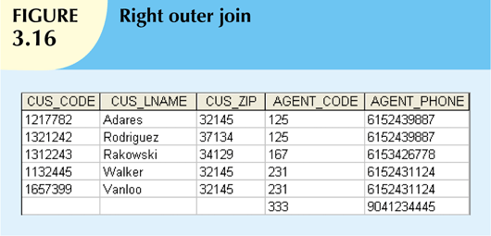

Slide 54
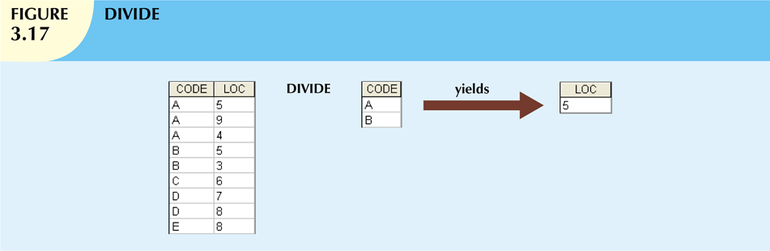

Slide 55

Summary
Tables are basic building blocks of a relational database
Keys are central to the use of relational tables
Keys define functional dependencies
Superkey
Candidate key
Primary key
Secondary key
Foreign key

Slide 56

Summary (cont’d.)
Each table row must have a primary key that uniquely identifies all attributes
Tables are linked by common attributes
Good design begins by identifying entities, attributes, and relationships
1:1, 1:M, M:N
The relational model supports relational algebra functions
SELECT, PROJECT, JOIN, INTERSECT UNION, DIFFERENCE, PRODUCT, DIVIDE

